Slide 1
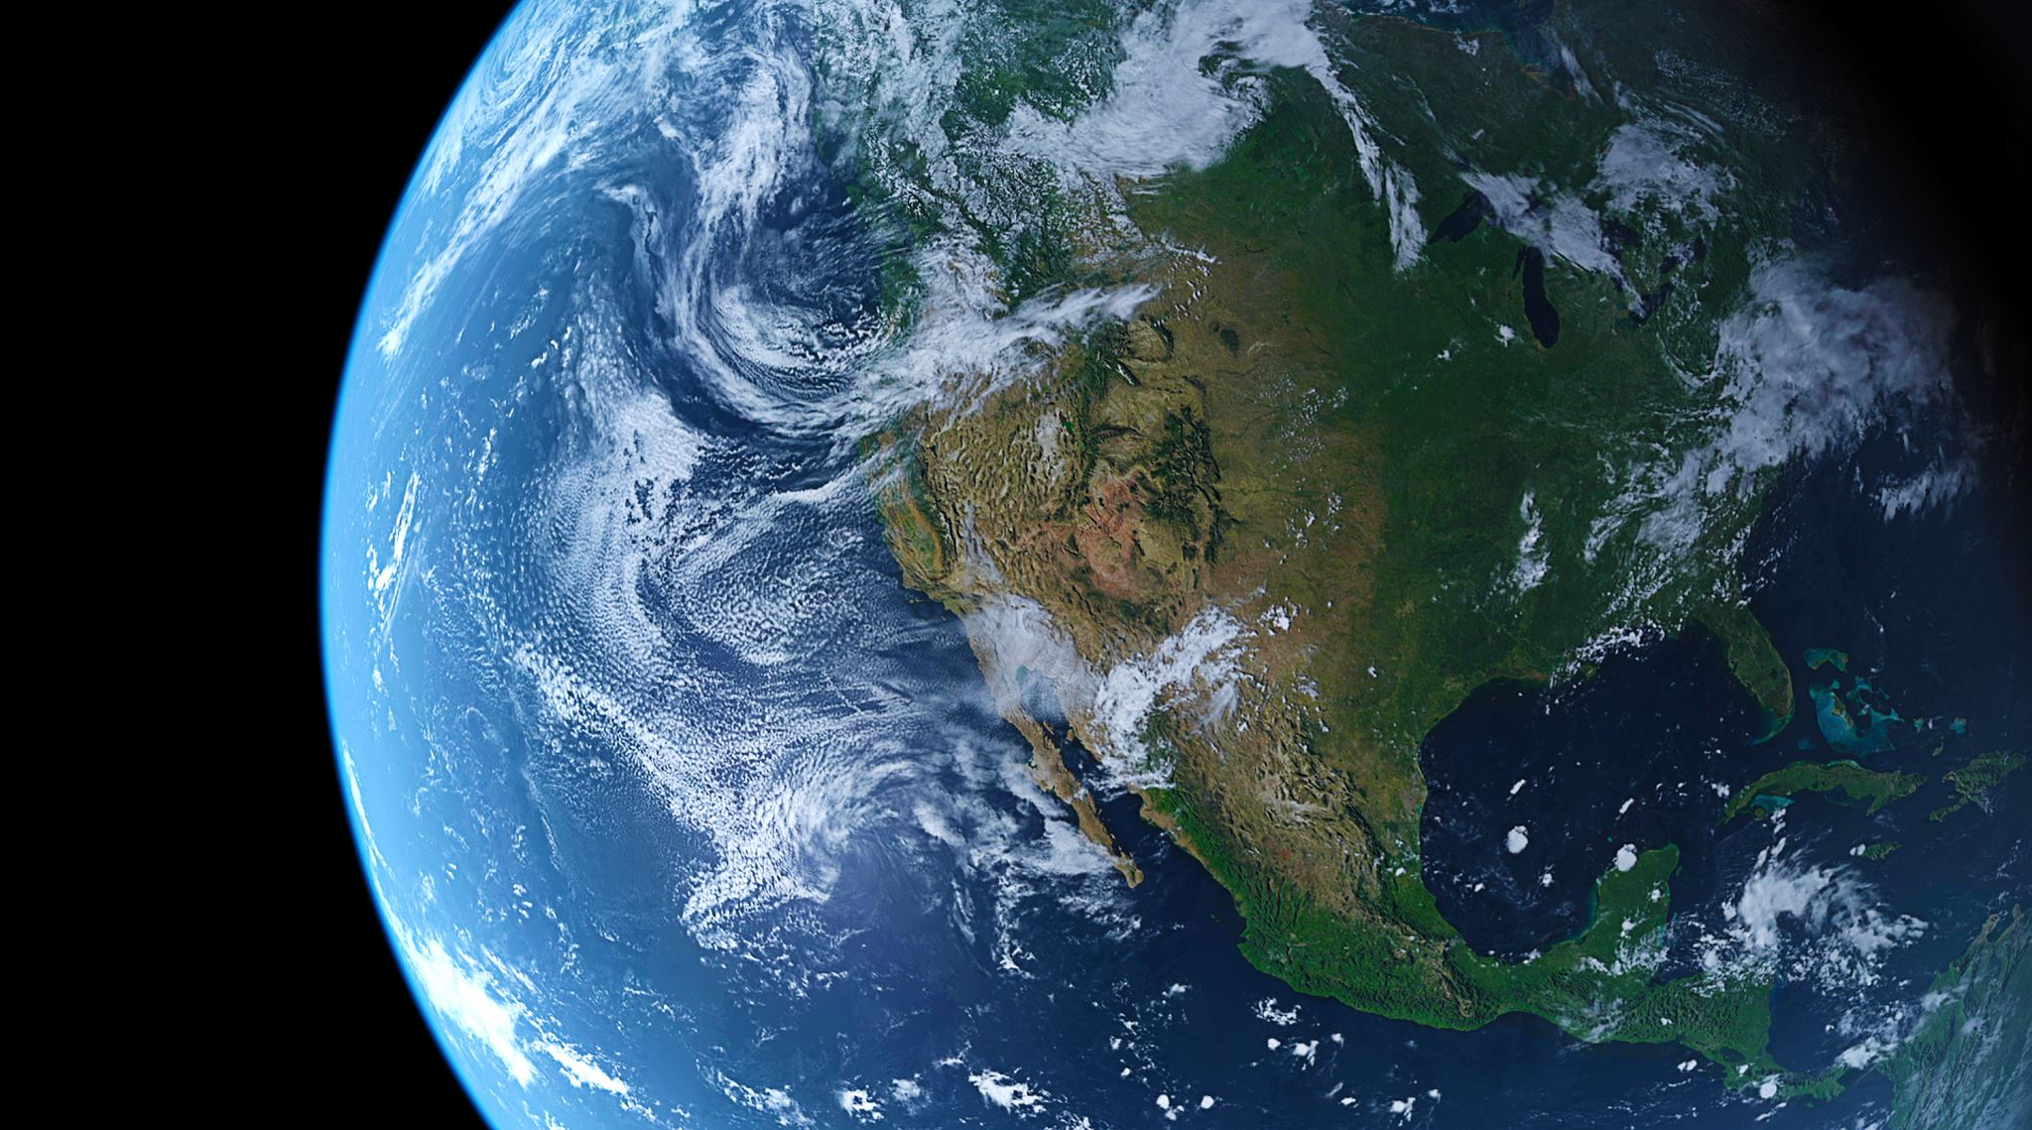
Mastering Earth Observation with AI & Google Earth Engine
Learn how to analyze and map Earth’s changes using GEE, Machine Learning, and Deep Learning

Slide 2
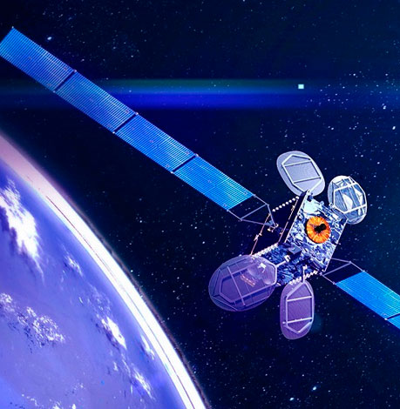
Course Objective
Understand Google Earth Engine (GEE) and its applications in remote sensing
Perform LULC mapping using machine learning and deep learning
Conduct disaster mapping (forest fire, floods, landslides) using multi-temporal satellite data
…..and many more!

Slide 3
Who should take this course?
This course is ideal for:
✅ Students & Researchers in GIS, Remote Sensing, and Environmental Science
✅ Data Scientists looking to expand their geospatial analysis skills
✅ GIS Professionals working with Earth Observation and AI-based mapping
✅ Disaster Management Experts interested in satellite-based risk assessment
✅ Developers & Enthusiasts eager to explore Machine Learning and Deep Learning in geospatial applications

Slide 4
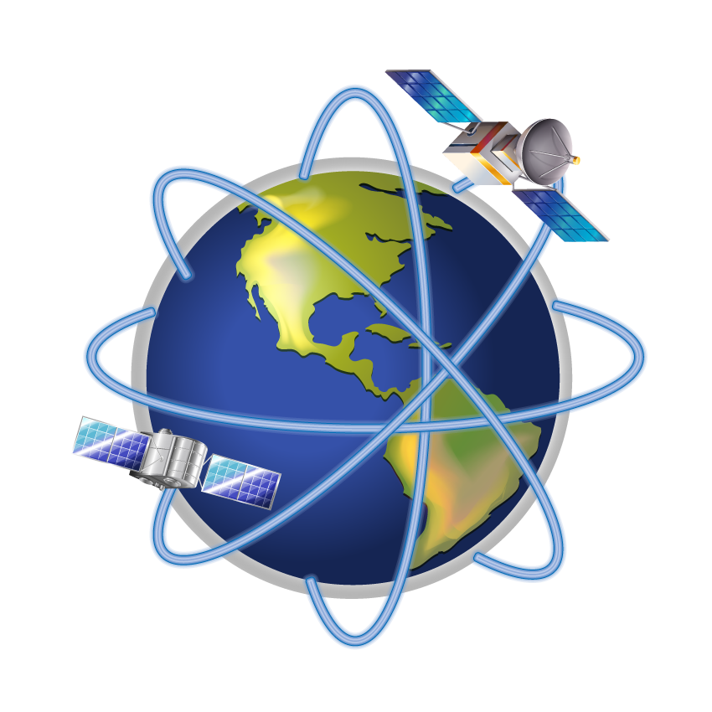
Prerequisites
Basic understanding of GIS and Remote Sensing (helpful but not mandatory)
Familiarity with python programming (beginner level)
Basic knowledge of Machine Learning and Deep Learning

Slide 5

Why should you join this course?
🎯 Hands-on Learning – Work on real-world projects using satellite data 🎯 AI-Powered Geospatial Analysis – Learn Machine Learning & Deep Learning for mapping 🎯 Practical Applications – Solve real environmental problems (floods, fires, landslides) 🎯 No Expensive Software Required – Utilize the power of cloud-based GEE 🎯 Join a Growing Field – Remote sensing and AI skills are in high demand

Slide 6
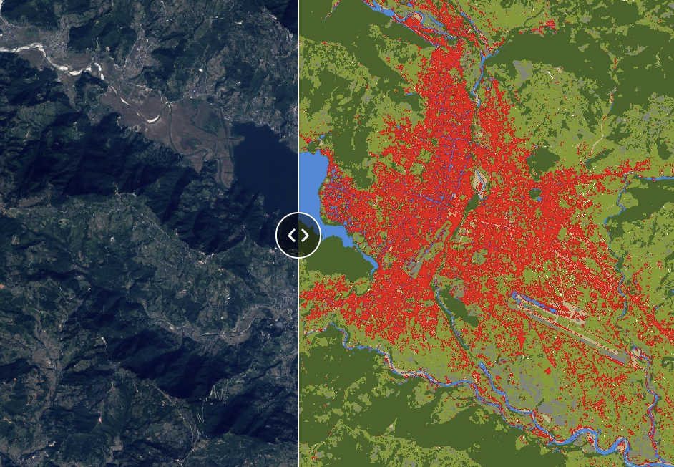
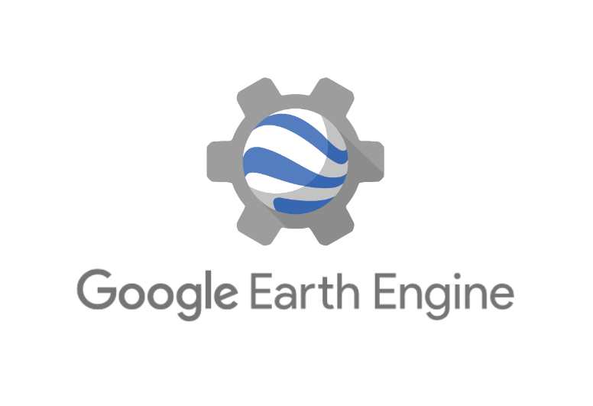
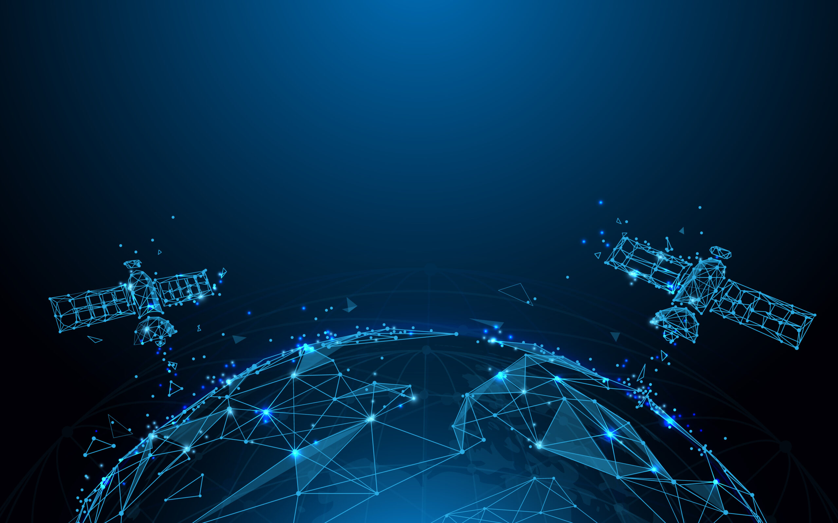
What’s inside this course?
Remote sensing basic
LULC Mapping

Slide 7
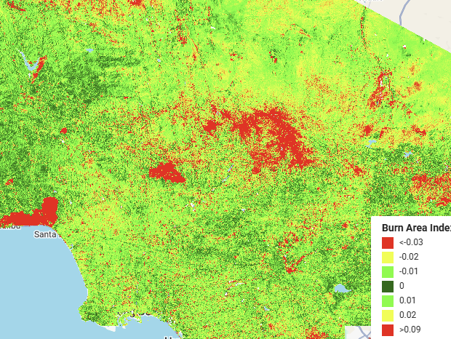
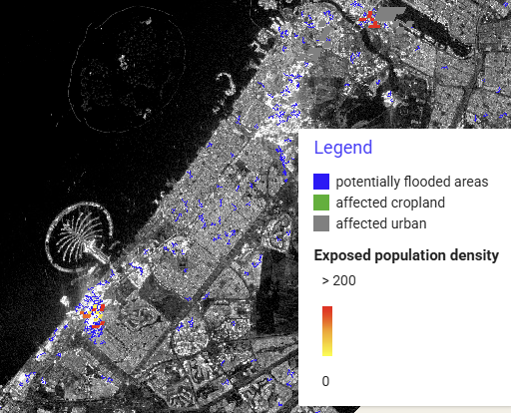
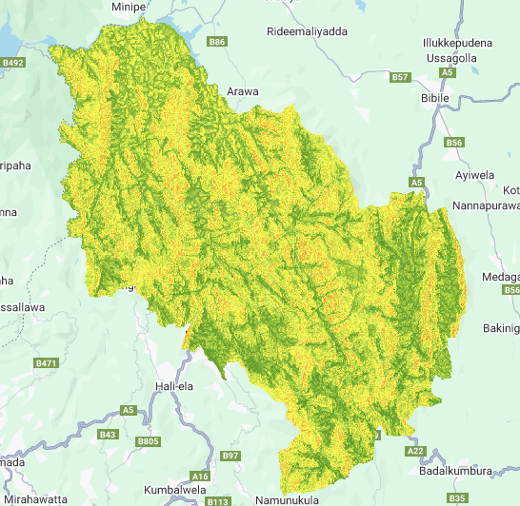
What’s inside this course?
Forest Fire Mapping
Flood mapping
Landslide Susceptibility

Slide 8
What’s inside this course?

Slide 9

… More tutorials will be added in future!

